Slide 1
Numerical Analysis
Bisection Method
Lab 08
G Capt® Umar Farooq
Demonstrator Kabeer Ahmed
MCS and MS Telecommunication Network

Slide 2
Bisection
Start: Given a,b and ε
u = f(a) ; v = f(b)
c = (a+b) /2 ; w = f(c)
no
yes
is
u w <0
no
is
(b-a) /2<ε
Stop
yes
b=c; v= w
a=c; u= w
Notes:
Convert to Speech:
A detailed flow chart of the Bisection algorithm is shown. The program starts with ay , be and epsilon.
Ae and be, the end points of the interval and epsilon is the accuracy level.
The function is evaluated at the end points and the values are stored in u and v.
In each iteration, the middle point c is computed and the function is evaluated and its value is stored in w.
If W times u is negative, That is ef of a times ef of c is negative then the new interval is ay see .
Otherwise the new interval is be see
A stopping criterion is used here. If the size of the interval is less than a desired accuracy level the algorithm is stopped, otherwise the procedure is repeated.

Slide 3
Bisection
Following formula is used to find the maximum number of iteration
max1=1+round((log(b-a)-log(delta))/log(2));
Addition of 1 is to ensure that the tolerance is achieved before number of iteration is completed.

Slide 4
PROGRAM bisect.m
function [k,c,err,yc]=bisect(f,a,b,delta)
%Input - f is the fun - delta is the tolerance - a and b are the left and right endpoints
%Output - c is the zero - yc= f(c) - err is the error estimate for c
ya=feval(f,a); yb=feval(f,b); c=(a+b)/2; err=abs(b-a); yc=feval(f,c);
if ya*yb>=0
fprintf('The root is not lying in interval')
return
end
max1=1+round((log(b-a)-log(delta))/log(2));
fprintf('\t\t\tLeft\t\t\t\t\t\t\tRight\t\tFun Value\n')
fprintf('k\t\t endpoint\t\t Midpoint\t\t\tendpoint\t\tf(c)\n')
for k=1:max1
c=(a+b)/2; yc=feval(f,c);
fprintf('%d \t %15.8f\t%15.8f\t%15.8f\t%15.8f\n',k,a,c,b,yc);
if yc==0
a=c; b=c;
elseif yb*yc>0
b=c; yb=yc;
else
a=c; ya=yc;
end
if b-a < delta, break, end
end
c=(a+b)/2; err=abs(b-a); yc=feval(f,c);

Slide 5
Bisection Example 1
Define a function in cosmx.m file
  function y=cosmx(x)
  y=cos(x)-x;
Draw the graph of f(x)=cos(x)-x in command window.
>> fplot(‘cosmx', [-pi pi])
>>grid on
The root is lying in the interval [0 1]

Slide 6
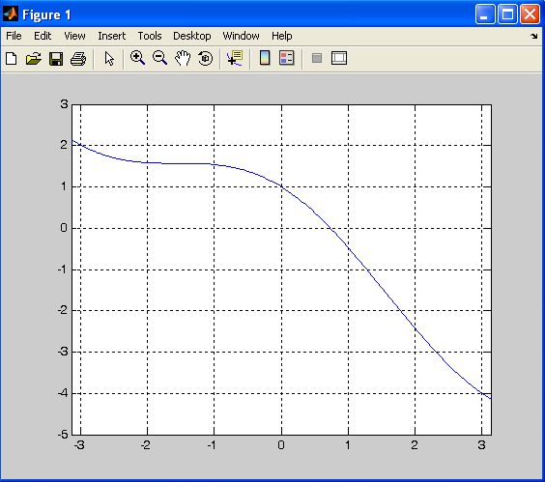

Slide 7
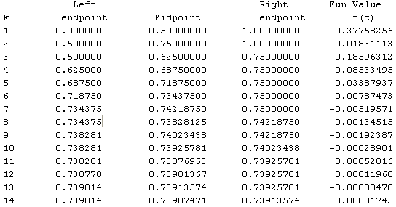
Bisection Example 1
>> [k, c,err,yc]=bisect('cosmx',0,1,1e-4)
k = 14
c = 0.7391
err = 6.1035e-005
yc = -3.3625e-005

Slide 8
Bisection Example 2
Define a function
  function y=xsinm1(x)
  y=(x*sin(x))-1;
Draw the graph of f(x)=cos(x)-x in command window.
>> fplot(‘xsinm1', [0 2])
>>grid on
The root is lying in the interval[1 1.2]

Slide 9
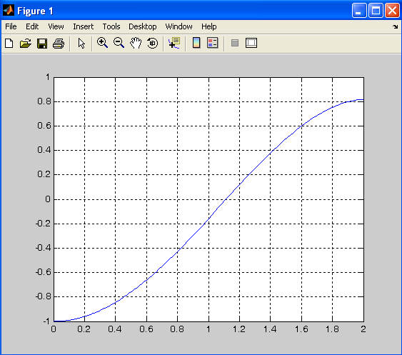

Slide 10
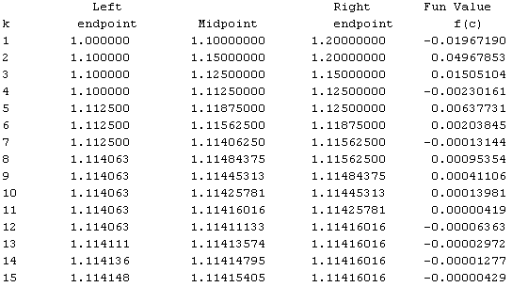
Bisection Example 2
>> [k,c,err,yc]=bisect(‘xsinm1',1,1.2,1e-5)
k = 15
c = 1.1142
err = 6.1035e-006
yc = -5.0525e-008

Slide 11
Exercise Questions
Name Formula Interval AppRoot #Steps
f1 x^2-9 [0 5] 3 1
f2 x^6-x-1 [1 2] 1.1347 15
f3 2*x-exp(-x) [-10 10] 0.3517 17

Slide 12
Exercise Questions
Consider finding the root of f(x) = x² - 3. Let ε_{step} = 0.01, ε_{abs} = 0.01 and start with the interval [1, 2].
  Ans: k =4, c =1.7344, err =0.0062, yc =0.0081
Consider finding the root of f(x) = e^{-x}(3.2 sin(x) - 0.5 cos(x)) on the interval [3, 4], this time with ε_{step} = 0.001, ε_{abs} = 0.001.
  Ans: k =8, c =3.2965, err =7.8125e-004, yc =1.2590e-005
Consider function f(x) = sin(x) starting with [1, 99], ε_{step} = ε_{abs} = 0.00001, and comment.

